Slide 1

Online Store Analysis
By Raj Brar
Time Frame : 2017-2019
Data Source: https://www.kaggle.com/datasets/tylermorse/retail-business-sales-20172019
Tables: business.retailsales.csv, business.retailsales2.csv

Slide 2
Overview
The objective of this project is to analyze and provide feedback for an Online business who has been struggling. The work was completed in Tableau, and commentary will be provided throughout the deck to showcase:
thought process related to the data and
gaps within the data source
recommendations that would yield additional benefits
The goal was to gain valuable experience in Tableau, thus all the charts, tables and analysis were completed within Tableau and subsequently exported to PowerPoint.

Slide 3
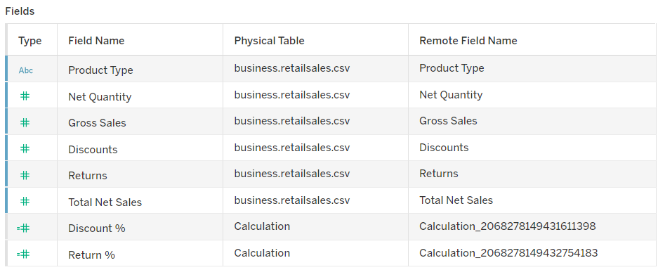
Data Set
Table: business.retailsales.csv

Slide 4
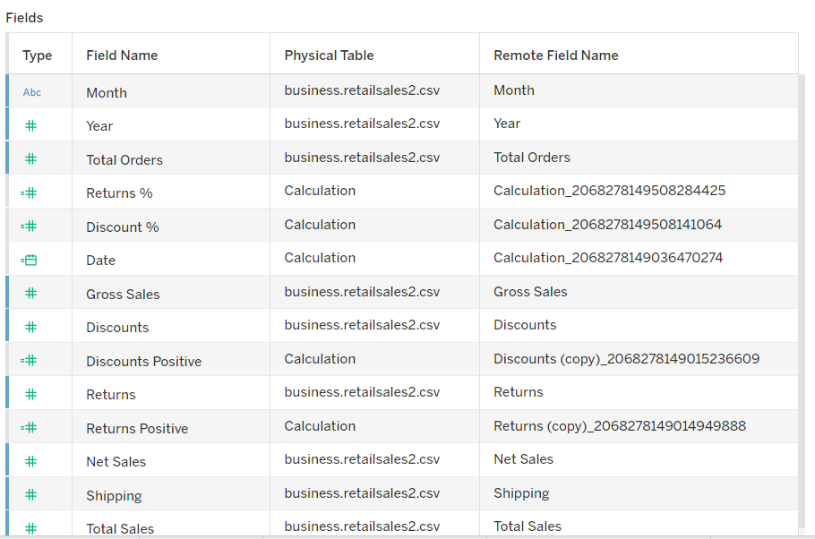
Data Set
Table: business.retailsales2.csv

Slide 5
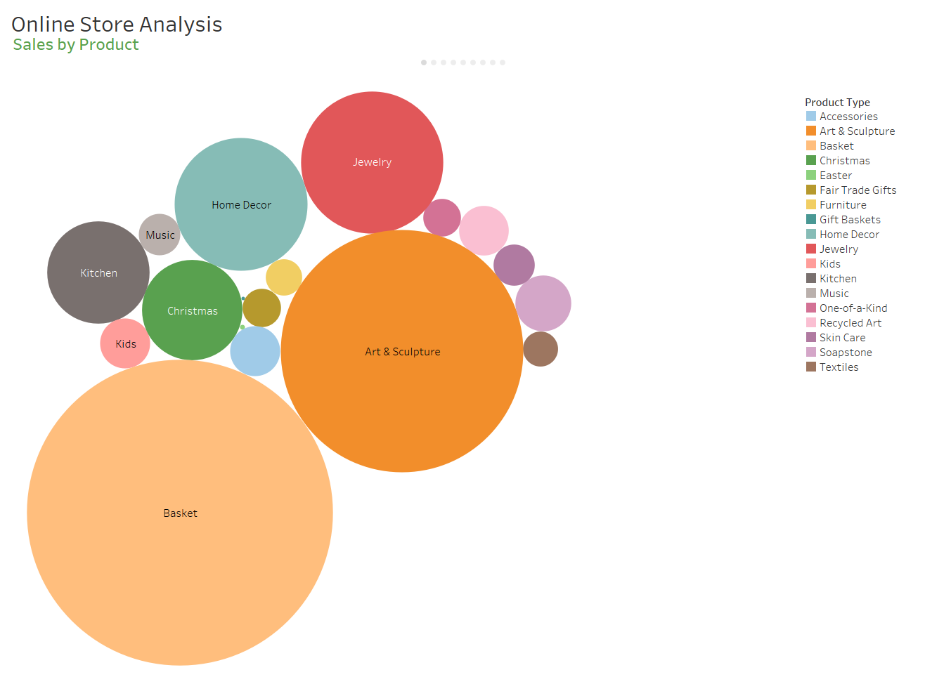
Commentary:
This high-level visual is to showcase the highest grossing products, but also that there are many products which are not producing much revenue. It sets the initial tone for more detailed analysis on future slides.

Slide 6
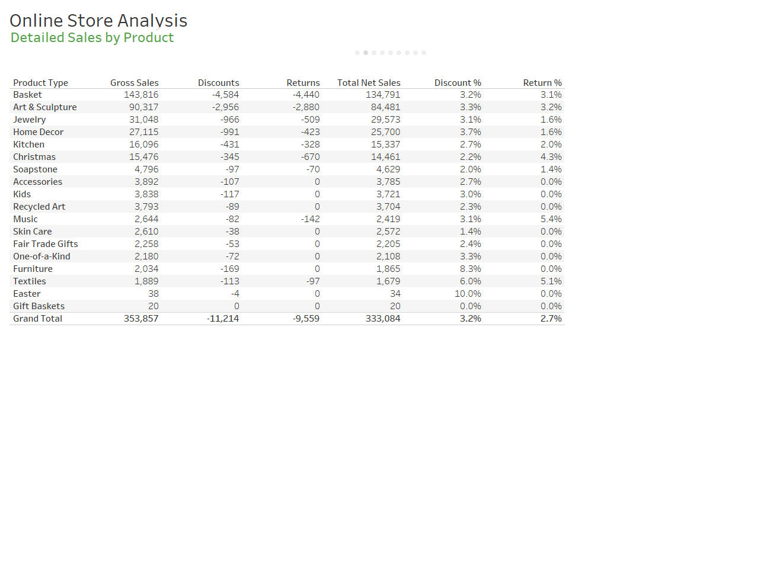
Commentary:
Detailed view with the intention of providing insight into the size with respect to dollars, but also to show what other data is available which will be further refined in future slides.
This data set did not include Discount % or Return %, these were added so that deeper knowledge could be gained on which product revenue is driven by discounts or which products are resulting in high returns and impact profitability.
A major gap which is evident is the absence of costs, so it is not possible to analyze profitability, nor can a proper product mix be determined without this knowledge. For instance, Baskets are producing high sales, but if their margins are low, it may be more beneficial to try and focus on selling Kids products if the margins are higher in this category.

Slide 7
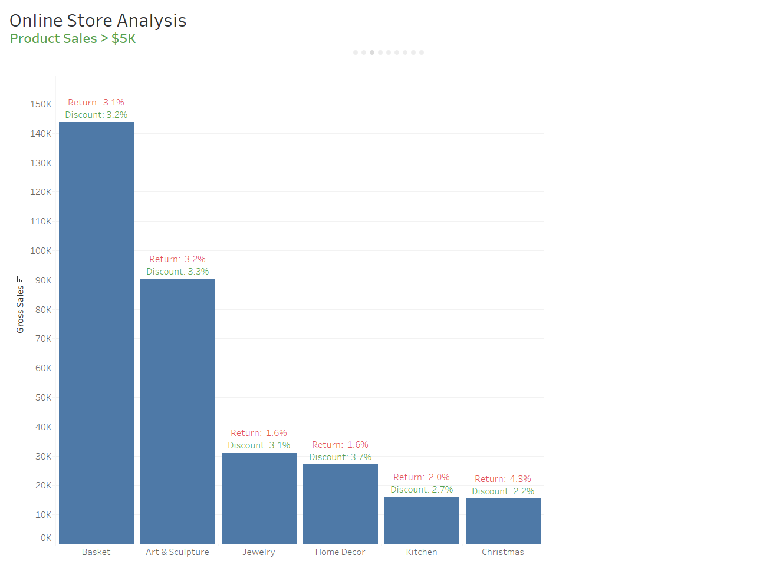
Commentary:
A visual of products with sales above $5K, which demonstrates the concentration of revenues, and provides additional insight into how much the products are discounted and to what degree returns occur.
The intention here is to be able to determine what products require high discounts in order to achieve the sales level. Although this information provides high level insight, deeper analysis at the product level within each category should be evaluated further to find the specific products.
The same logic applies to the returns, it is clear the first two categories have some of the highest returns as a percentage of sales. The data doesn’t provide specific products, the data set needs to be expanded to find out what products are leading to high returns. Also, customers should be surveyed for feedback in order to gain further insights.
Returns and discounts need to be considered in relation to margins, as they directly impact the bottom line. Low margin items may not be able to be able to absorb these added costs, hence margins and profitability are a necessity in the data set to provide meaningful insight on whether discounts are appropriate given the rate of returns that are occurring.

Slide 8
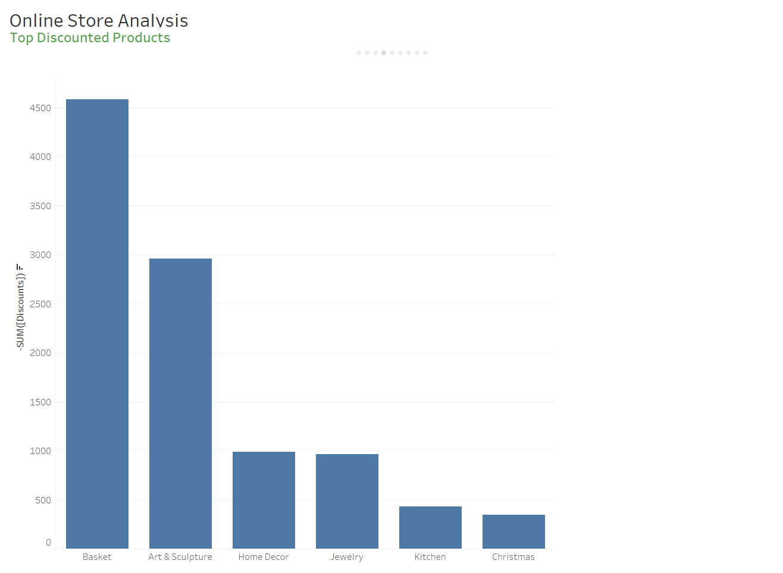

Slide 9
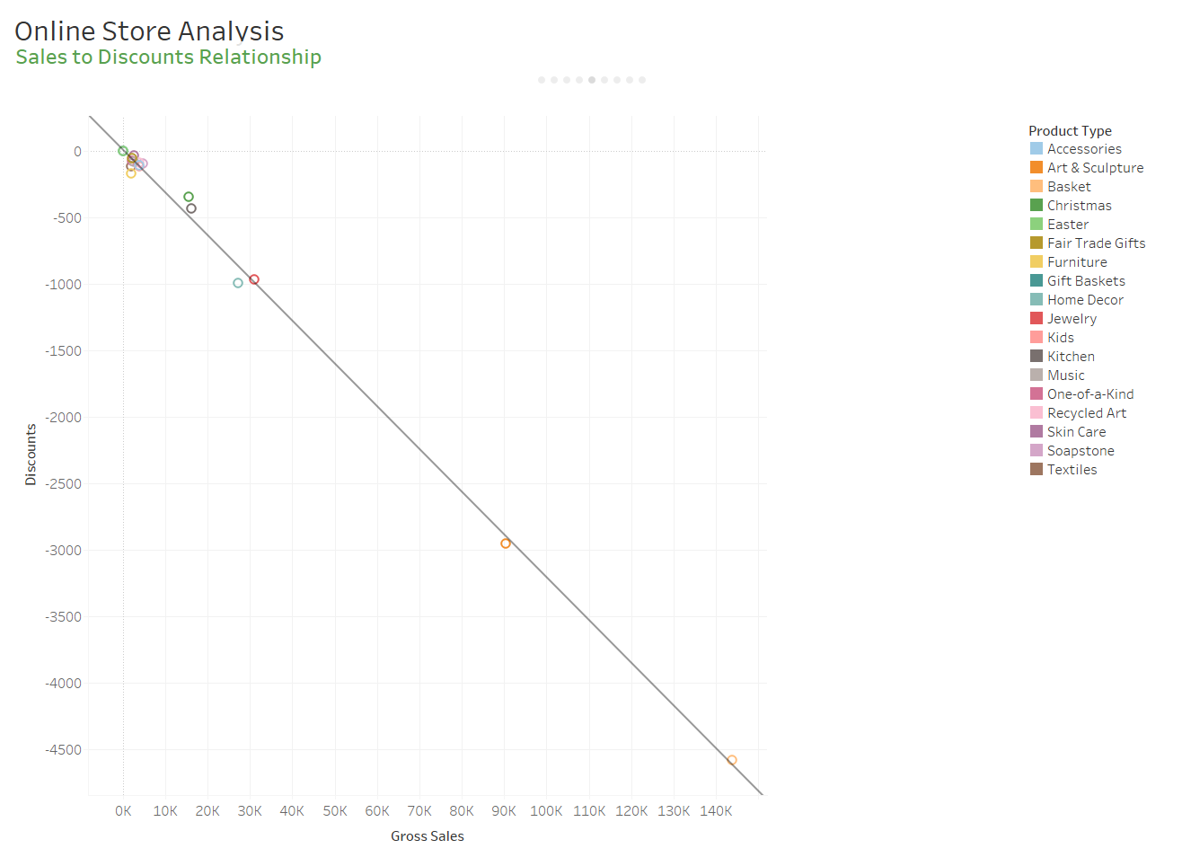
Commentary:
This graph represents the relationship between Discounts and Gross Sales across all product types.
On a macro level, the trend line shows that as greater discounts are offered, it yields greater overall sales, and this is true across all product lines in general. Also, the relationship is linear in nature, and holds true for all product types.
The graph shows that there is a heavy concentration of products where the sales and discount levels are fairly low, hence a deeper dive is required on these products to see if the linear relationship still holds true, which is what the next slide provides.

Slide 10
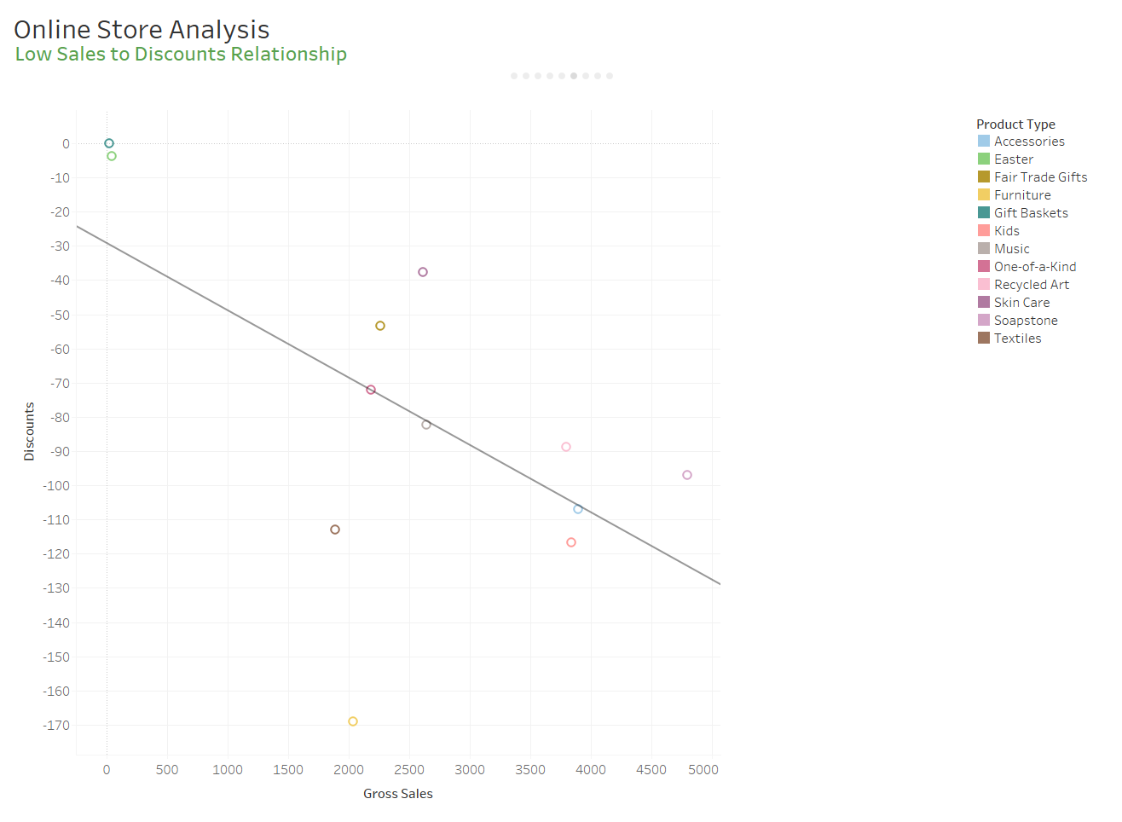
Commentary:
A deeper dive for those products with lower sales volumes show that the linear relationship doesn’t hold for these products. Most of the lower sales products are above the trend line, indicating that they do not require as much of a discount, where items such as Furniture requires a higher discount but doesn’t provide for the higher gross sales anticipated.
Profitability vs Discounts would have provided more insight, as the Furniture discount may be valid if the level of profit was higher and able to absorb the discount amount.

Slide 11
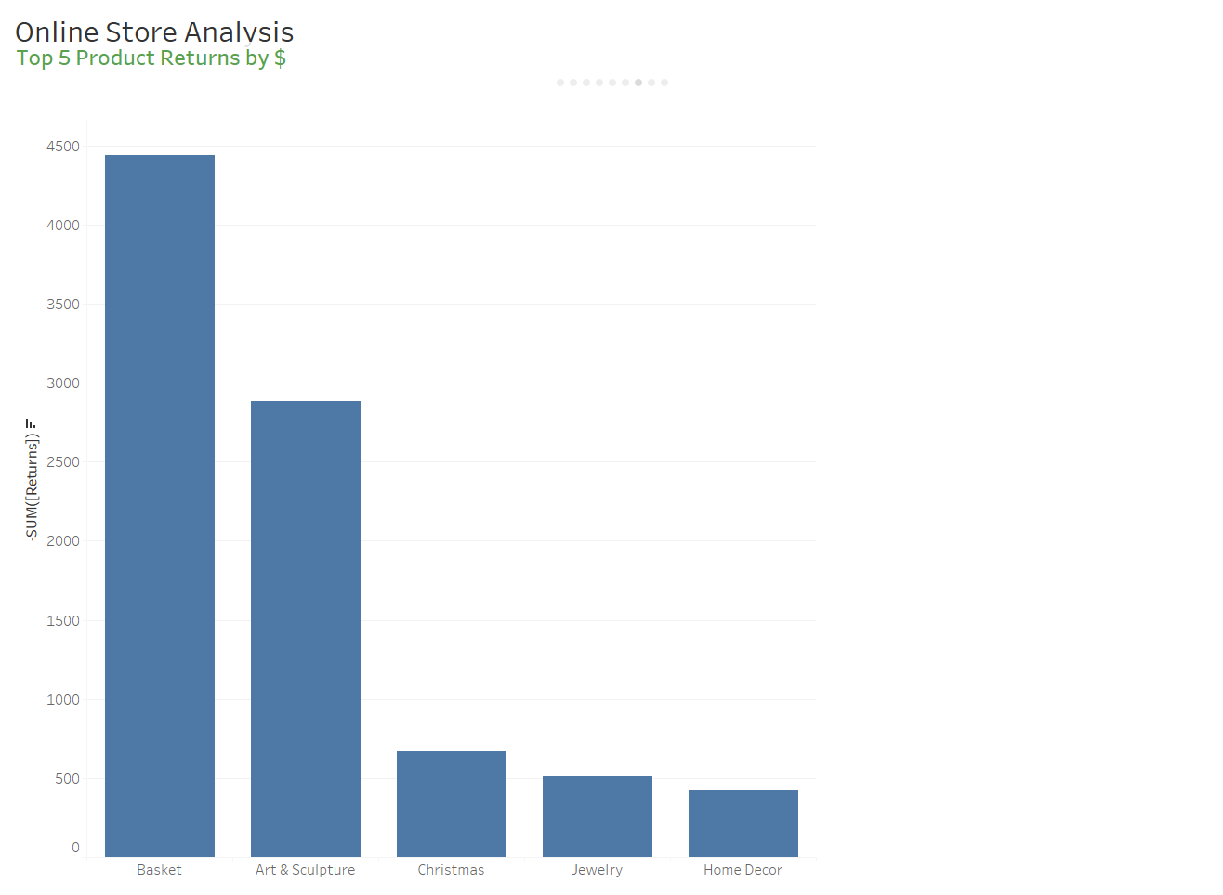
Commentary:
Product returns often cannot be resold and directly impact profitability. A deep dive into the product category responsible for the returns should be evaluated in detail, so that the reasons behind the returns can be evaluated and adjustments can be made.
Client feedback should be gathered whenever a client returns a product, in order to reduce the return rate over time. For example, the returns could be due to damage during shipping or possibly the product picture did not represent the actual product. The remediation for each of these would be different.
Time based data is not provided, so it’s unclear if the returns are increasing or improving over time.

Slide 12
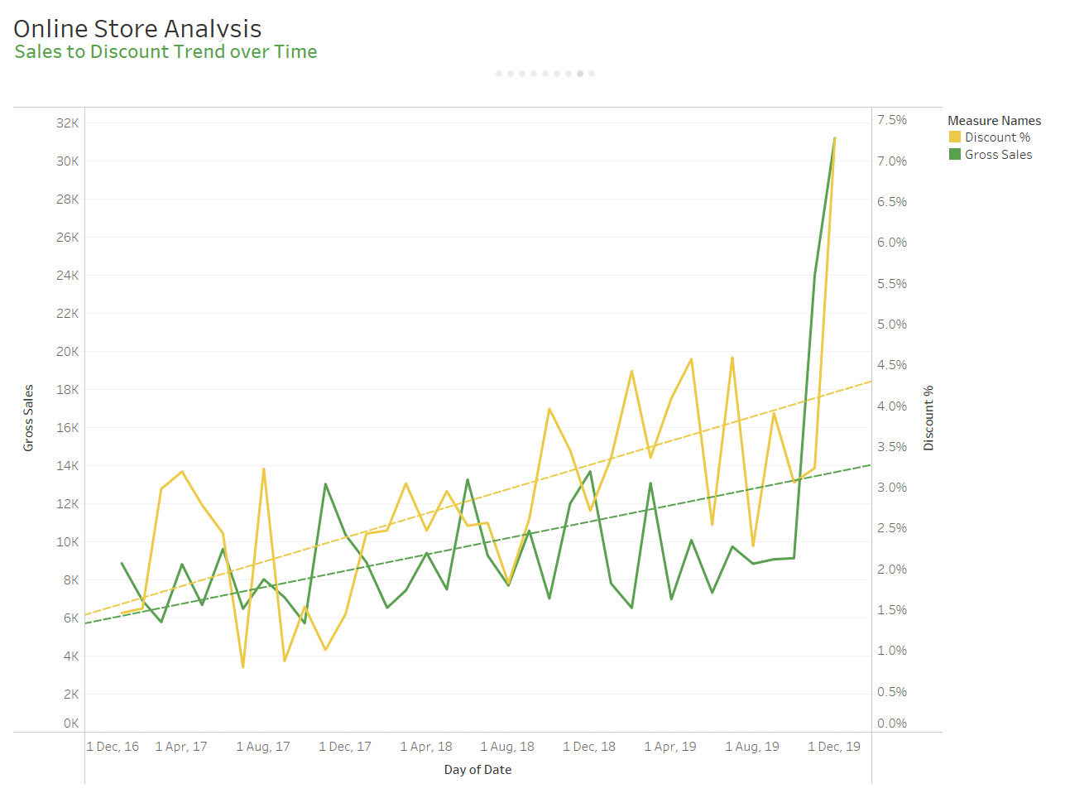
Commentary:
Time based data is provided for all products for Sales Discount Percentage and the overall Gross Sales; hence it’s not broken down by product.
A few interesting points are displayed here which require a further deep dive.
When discounts are higher (yellow line peaks), sales are lower (green valley)
As the discount rate increases, the rate at which sales increases is lower (yellow slope line is steeper than green slope line)
An unusual spike occurred in Dec 2019 for both discounts and sales

Slide 13
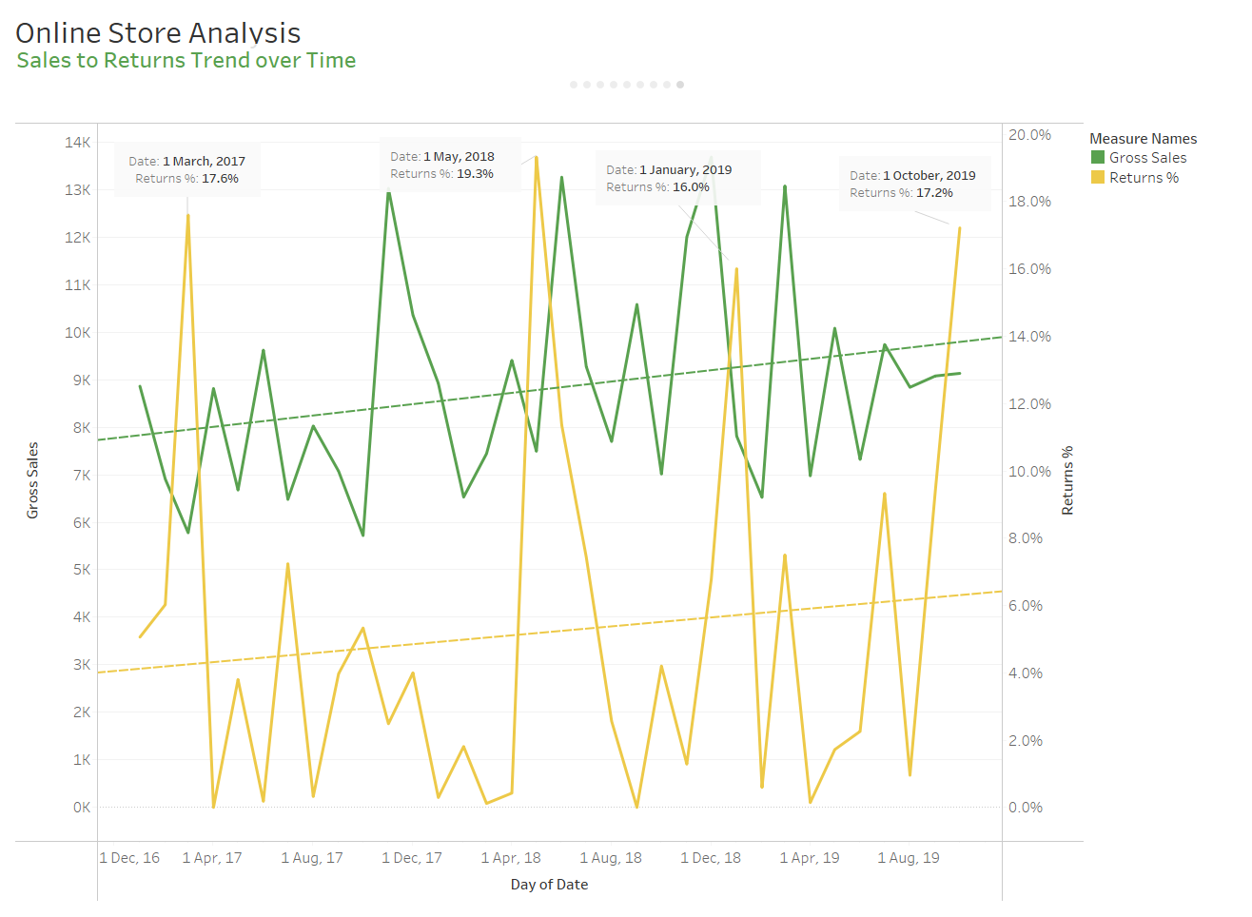
Commentary:
See next slide for detailed commentary.

Slide 14
Commentary:
The graph shows clear peaks where unusually high returns occur when compared to sales. The Return % amount is calculated by Return $/Gross Sales $ in the specific period. The raw data does not provide for returns by product for the period, this lack of information makes it difficult to decipher what products are driving the returns in each time period.
There are a few items of additional concern that should be investigated.
Returns % trend line is increasing as sales increase, need to investigate why these products are generating more returns rather than levelling off
Returns % has increased from ~4% to ~6% over two years, this is about 50% returns over time. There is a gap in the data set since there is no visibility of where the returns are coming from

Slide 15
Summary
The quality of the data determines the quality of information that can be derived for decision making. The data set that was provided had some clear deficiencies, being able to decipher these weaknesses on a real data set would allow for the possibility of attaining further data to allow for meaningful analysis. Some of the data gaps included:
Product data was provided as an aggregate rather than over a time period, so product analysis and insights over time were not possible
Financial metrics for profitability were not provided, so analysis of the impact of returns and sales could not be evaluated
Time period data set did not include product level details, and there was no way to join the two tables together to attain a full time and product data set

Slide 16
Summary - continued
The product mix is vast in the store, and once profitability is known, the online store may want to focus on those items that provide for the highest profit, lowest returns and don’t require many discount incentives to sell.
There needs to be further investigations into:
Why returns as a % are increasing, need to seek client feedback
Discount levels may need to be optimized; A/B Testing is recommended to see what amounts yield the best results
In lieu of discounts per product, group discounting or minimum spend discounting may reduce discount %
Product seasonality is not visible, this additional data may provide insight into warehousing management to allow for more efficient product ordering

Slide 17
Final Thoughts
This project was a great exercise to gain experience with Tableau and Data Analysis, and I hope with the additional commentary, it showed my abilities to dig through the data to find meaning, but also be able to know when the data set is lacking completeness or clarity.
To showcase my growing technical skills in Data Analysis, please view my other projects on GitHub which I will be uploading soon.

